Slide 1
Overview of Agentic AI Framework

Slide 2
What is an AI Agent?
Adel Nehme
VP of AI Curriculum, DataCamp

Slide 3

Jeeves: Our Travel AI Agent
1
Image generated with GPT-4o
INTRODUCTION TO AI AGENTS

Slide 4
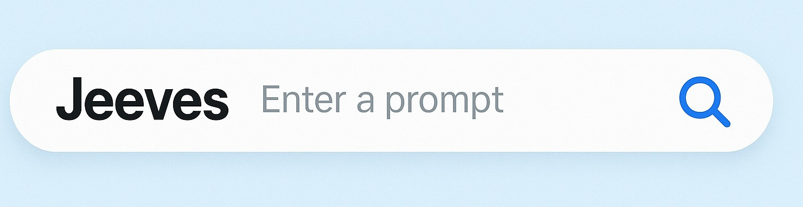
Jeeves: Our Travel AI Agent
Jeeves, I'm travelling to Tokyo on June 26 and staying there until July 12. Help organize my trip.
1
Image generated with GPT-4o
INTRODUCTION TO AI AGENTS

Slide 5
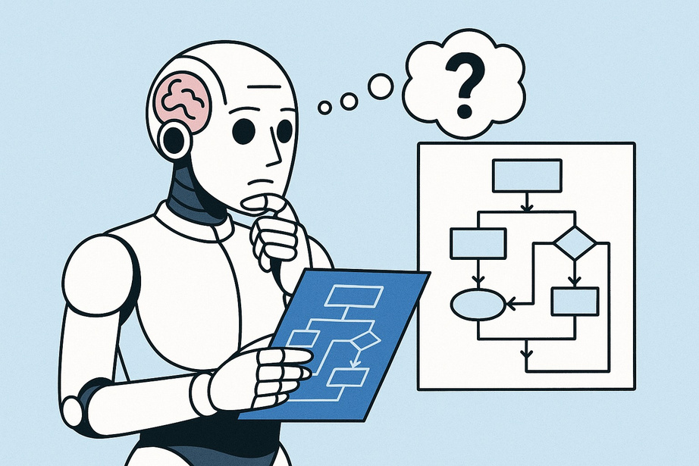
Reasoning and Planning
1. Access your itinerary and calendar
2. Identify where you'll need to stay based on
your meeting schedule
3. Identify relevant flights and hotels 4. Communicate the plan back to you 5. And finally, organize your travels
1
Image generated with GPT-4o
INTRODUCTION TO AI AGENTS

Slide 6
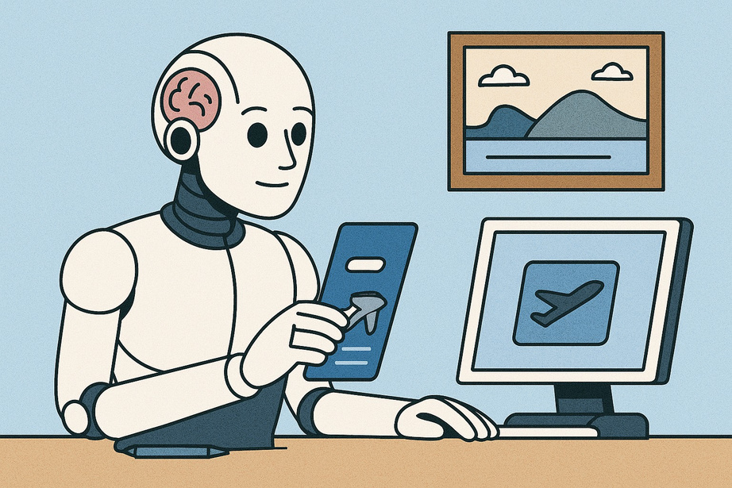
Taking Action
1. Your calendar and email to understand
your itinerary and meetings
2. Documentation on your company travel
policy to ensure compliance
3. Expedia and Booking.com to determine the
best flights and hotels
4. Communicates plan, and books travel
arrangements
1
Image generated with GPT-4o
INTRODUCTION TO AI AGENTS

Slide 7
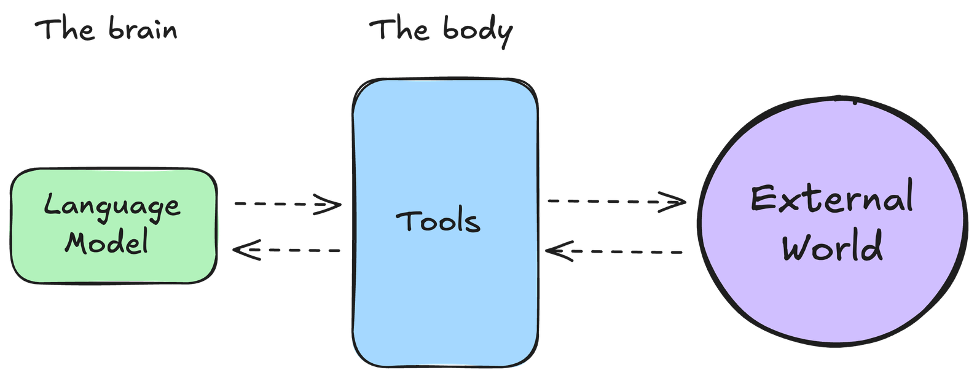
AI Agents: Reasoning, Planning, and Acting
An AI model capable of reasoning,planning,and acting on a set of actions by interacting
with its environment.
1
INTRODUCTION TO AI AGENTS

Slide 8
AI Agents: A Formal Definition
An agent is a system that leverages an AI model to interact with its environment to achieve a user-defined objective.
It combines reasoning, planning, and the execution of actions (often via external tools) to fulfill tasks.
1
INTRODUCTION TO AI AGENTS

Slide 9
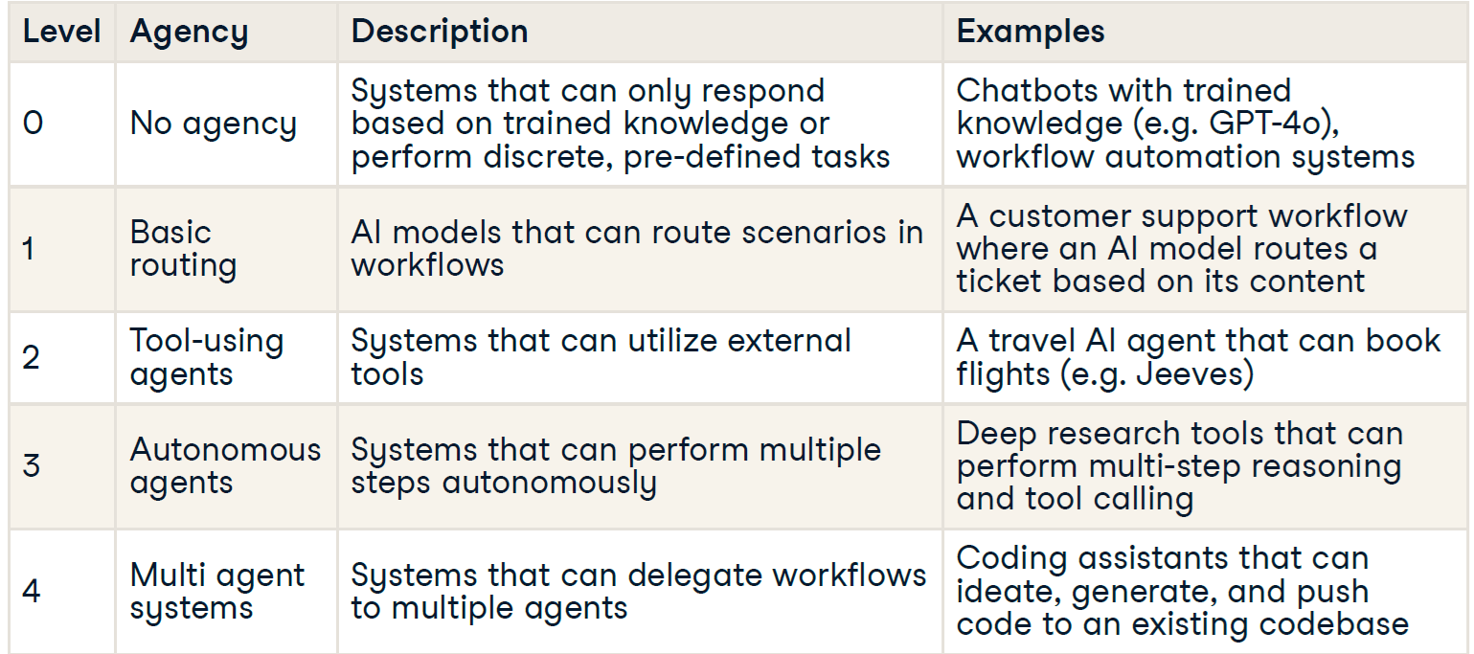
The Spectrum of "Agency"

Slide 10
What Makes an
Agent Agentic?
INTRODUCTION TO AI AGENTS
Adel Nehme
VP of AI Curriculum, DataCamp

Slide 11
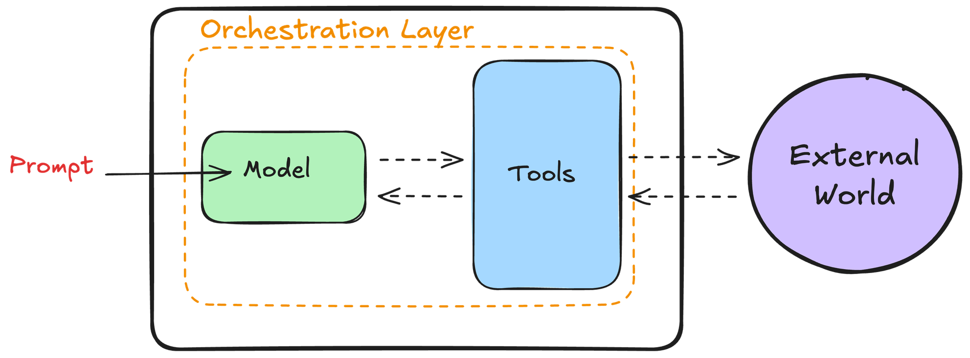
Components of an agent
1
INTRODUCTION TO AI AGENTS

Slide 12
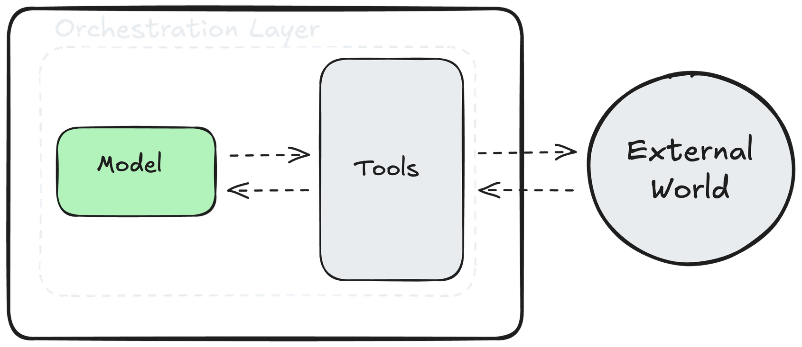
Components of an agent
1
INTRODUCTION TO AI AGENTS

Slide 13
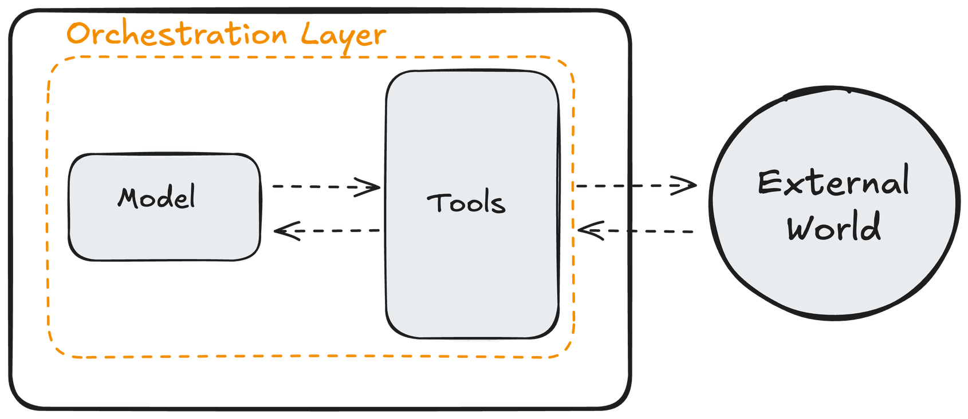
Components of an agent
BUILDING SCALABLE AGENTIC SYSTEMS

Slide 14
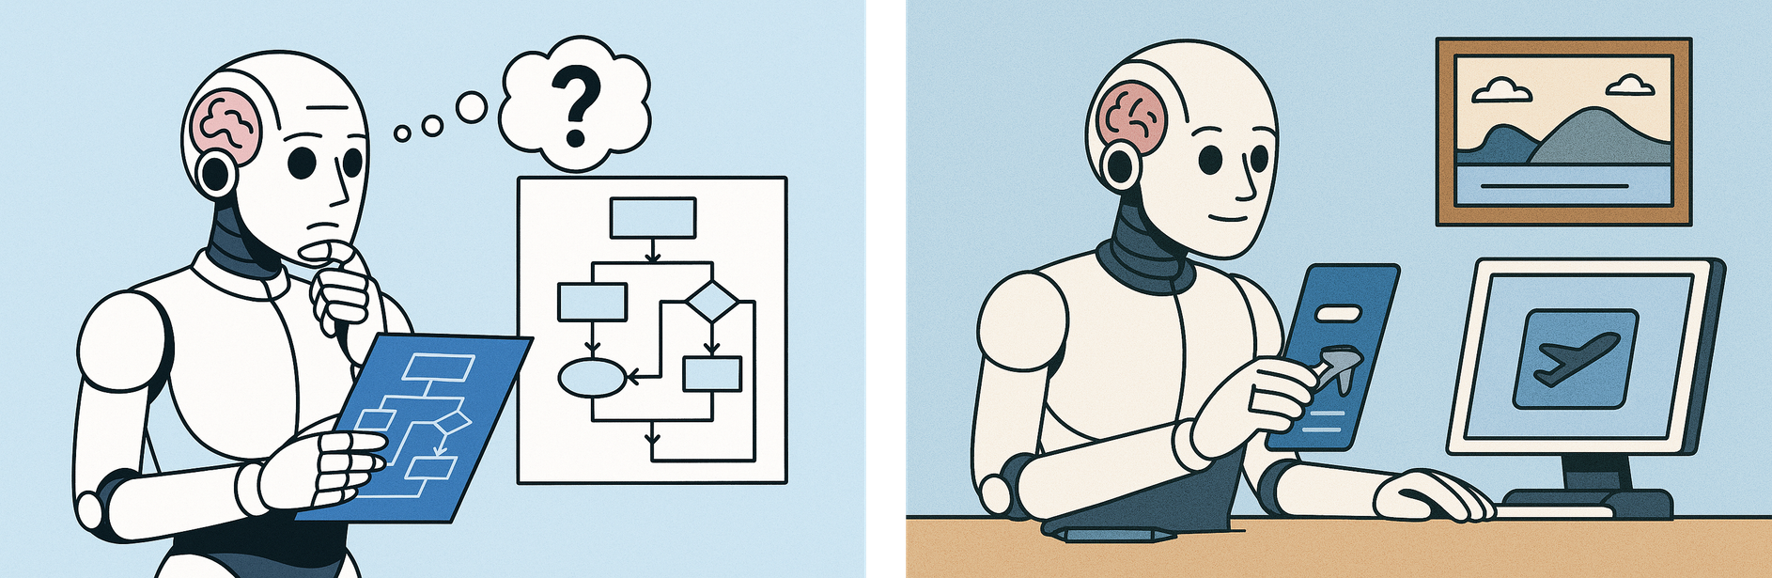
Jeeves: Our AI Travel Agent
1
Image generated with GPT-4o
INTRODUCTION TO AI AGENTS

Slide 15
The Agentic Trinity: Model
Jeeves, I am travelling toTokyo onJune26 and staying there until July 12. Help organize my trip.
"I need to access your itinerary and calendar"
"I need to access your email and
calendar to see your meeting schedule"
"I need to find flights that are compliant
with company policy"
"I need to find compliant hotels that are
close to your meetings"
"I need to communicate the travel
arrangements in a digesitble format"
INTRODUCTION TO AI AGENTS

Slide 16
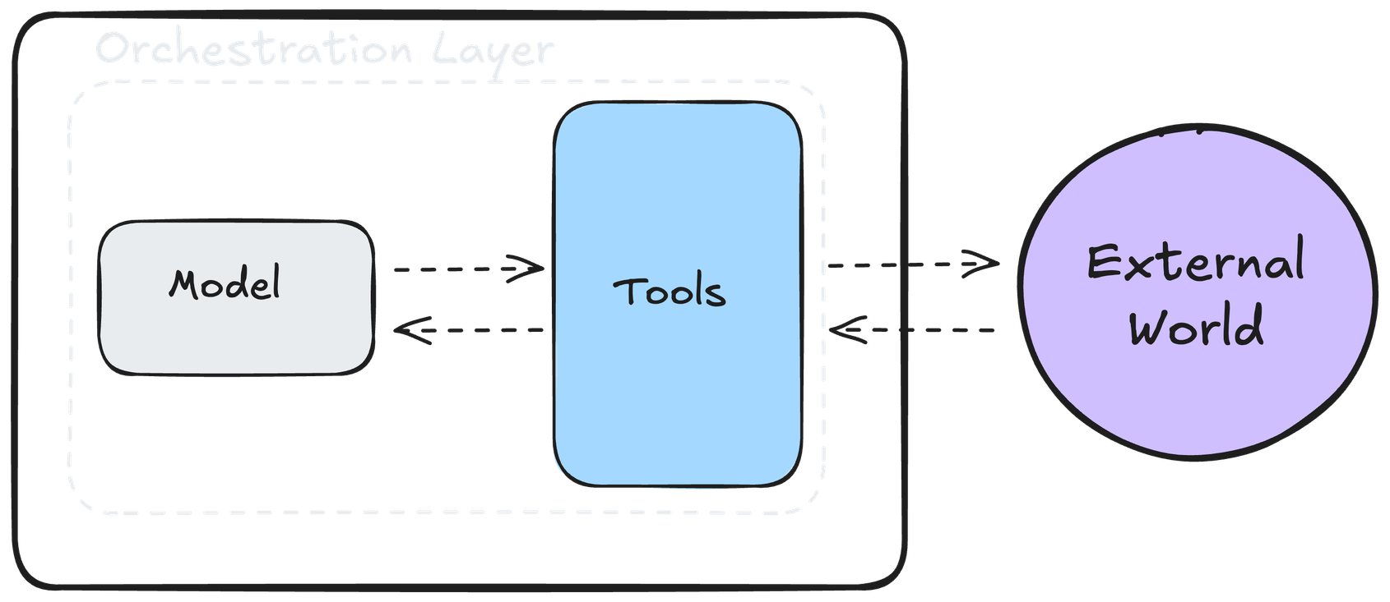
The Agentic Trinity: Tools
1
INTRODUCTION TO AI AGENTS

Slide 17
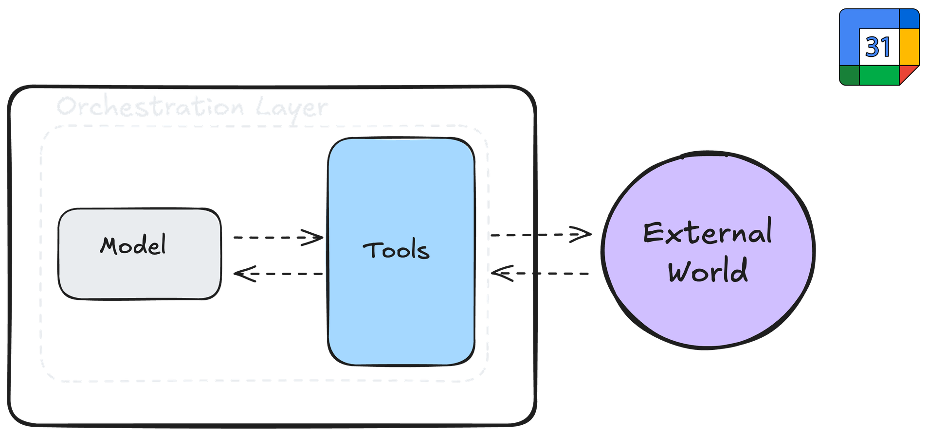
The Agentic Trinity: Tools
1
INTRODUCTION TO AI AGENTS

Slide 18
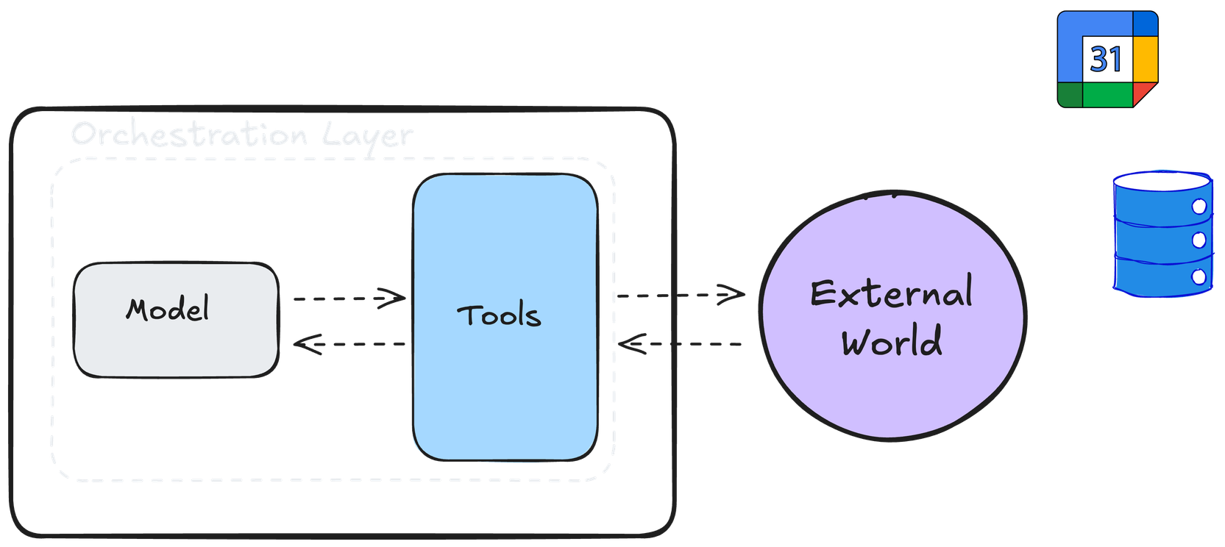
The Agentic Trinity: Tools
1
INTRODUCTION TO AI AGENTS

Slide 19
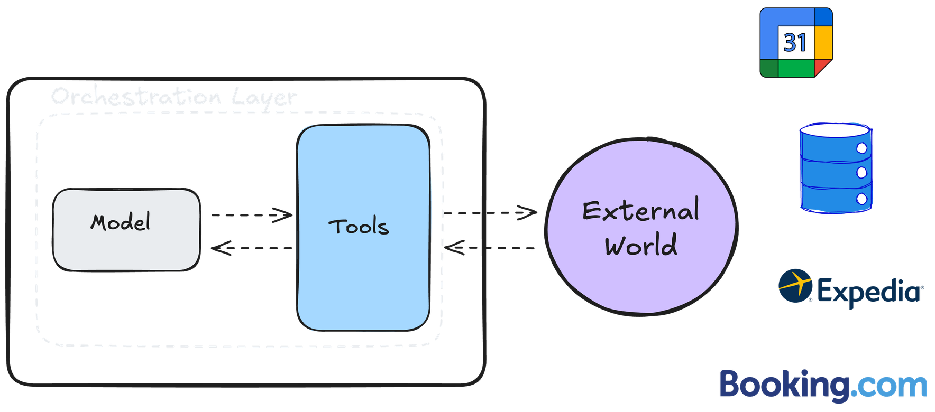
The Agentic Trinity: Tools
1
INTRODUCTION TO AI AGENTS

Slide 20
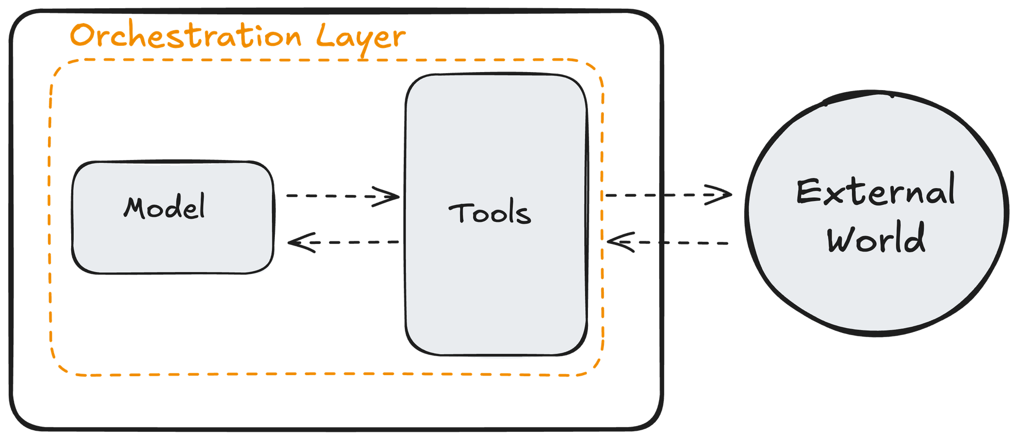
The Agentic Trinity: Orchestration
1
Wiesinger, J., Marlow, P., & Vuskovic, V. (n.d.). Agents.
INTRODUCTION TO AI AGENTS

Slide 21
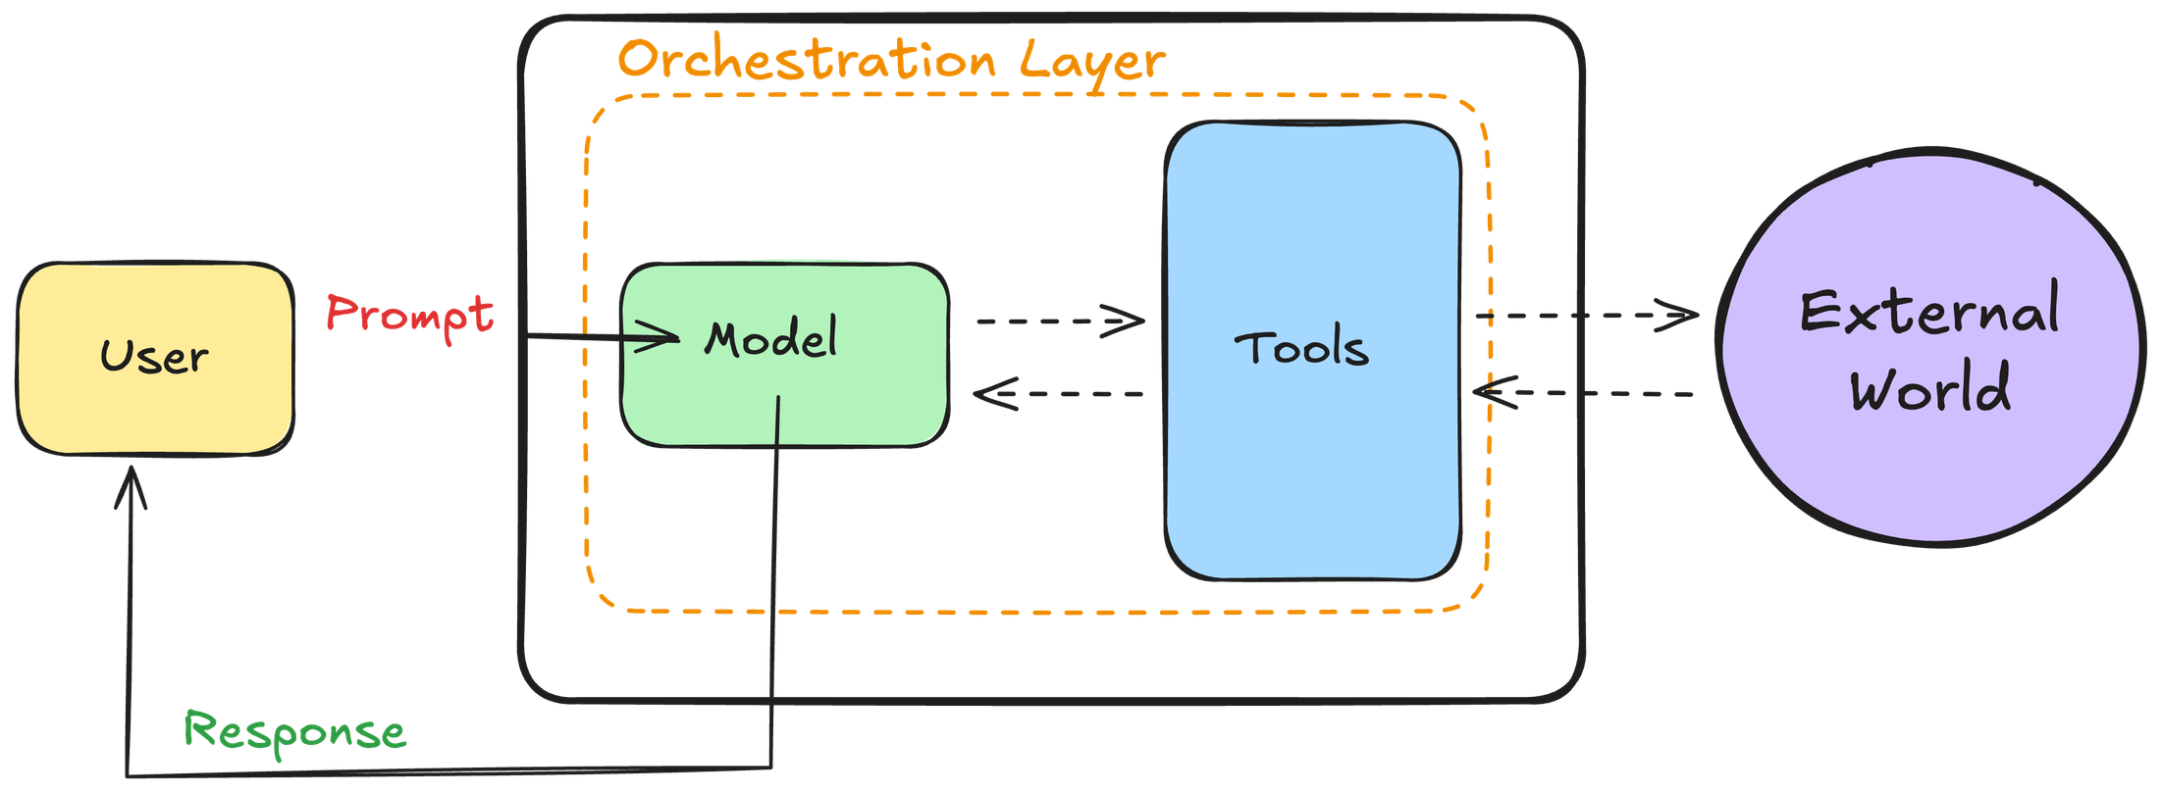
The Agentic Trinity: Orchestration
1
INTRODUCTION TO AI AGENTS

Slide 22
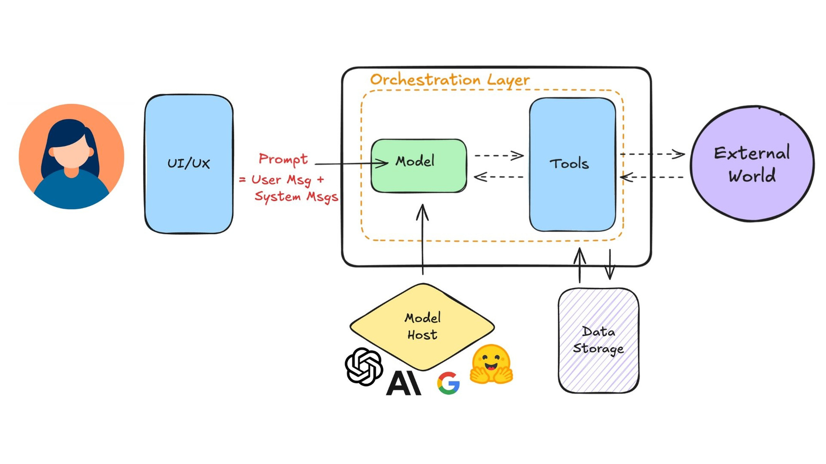
An agentic application
BUILDING SCALABLE AGENTIC SYSTEMS

Slide 23
To Agent or Not to
Agent?
INTRODUCTION TO AI AGENTS
Adel Nehme
VP of AI Curriculum, DataCamp

Slide 24
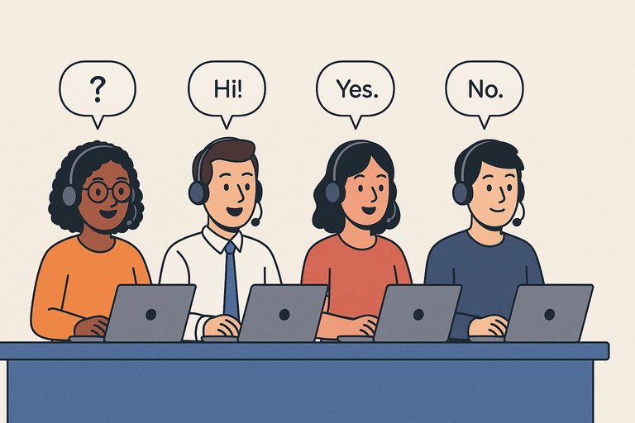

A Tale of Two Customer Support Teams
"How do I track my order?"
"How do I return an item?"
"How do I change my shipping address?"
"I was charged twice, but one order was cancelled, and I have store credit from a previous return that wasn't applied correctly"
1
Image generated with GPT-4o
INTRODUCTION TO AI AGENTS

Slide 25
The Tale of Customer Support Team A
"How do I track my order?"
"How do I return an item?"
"How do I change my shipping address?"
Problem qualities
They require simple decision-making
They do not require accessing customer information and history They all have discrete, predictable answers
INTRODUCTION TO AI AGENTS

Slide 26
The Tale of Customer Support Team B
"Iwas chargedtwice,but oneorderwascancelled,and I havestore credit from a previous
return that wasn't applied correctly."
Problem qualities
They require complex decision-making
They require accessing customer information and history They require adaptive solutions
INTRODUCTION TO AI AGENTS

Slide 27
A Tale of Two Customer Support Teams
A simple chatbot trained on pre-trained knowledge.
No tool use or actions required.
Agentic solution with tool access Can generate remediation strategies
and update systems
1
Images generated with GPT-4o
INTRODUCTION TO AI AGENTS

Slide 28
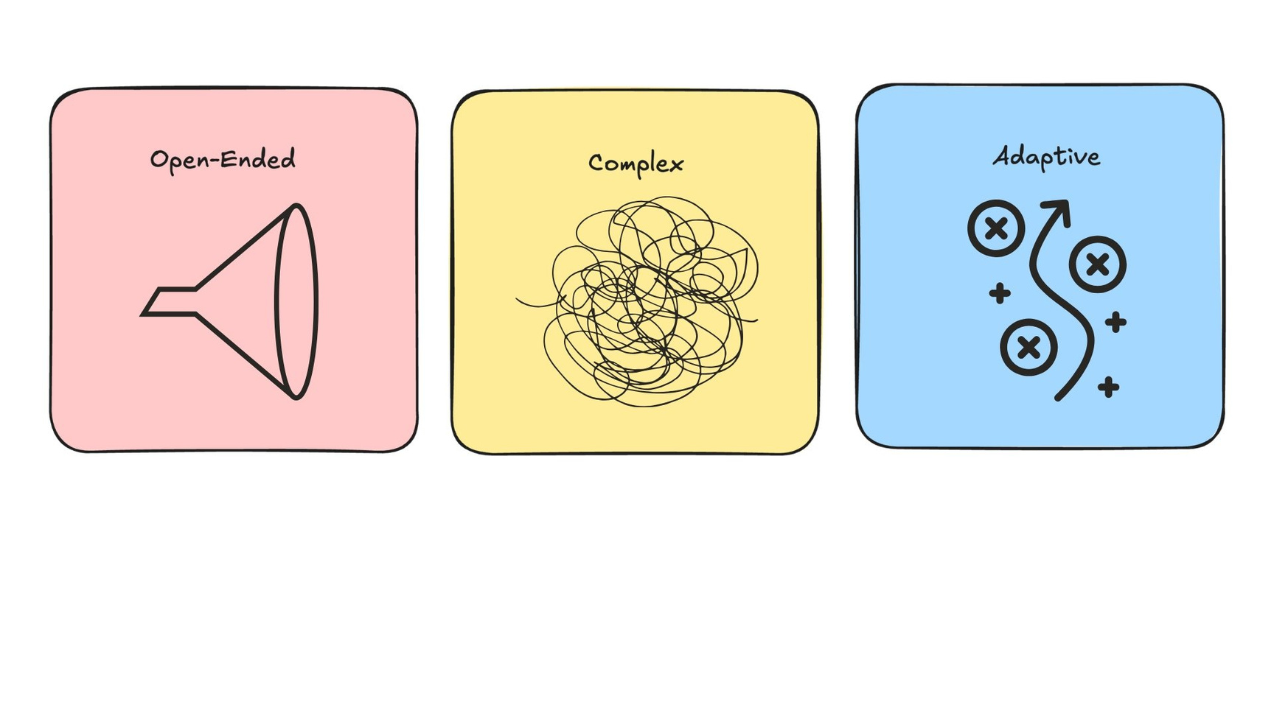
When to use agents?
BUILDING SCALABLE AGENTIC SYSTEMS

Slide 29
When to Use AI Agents
Criteria for using AI Agents
Examples of agentic use cases
1. Require complex decision-making
1. Autonomous customer support systems
2. Require heavy reliance on unstructured
2. Coding assistants that can read code
data
bases, provide updates, and implement them automatically
3. Have difficult to maintain rules
4. Require adaptive problem solving
3. A deep research assistant that can
synthesize research
INTRODUCTION TO AI AGENTS

Slide 30
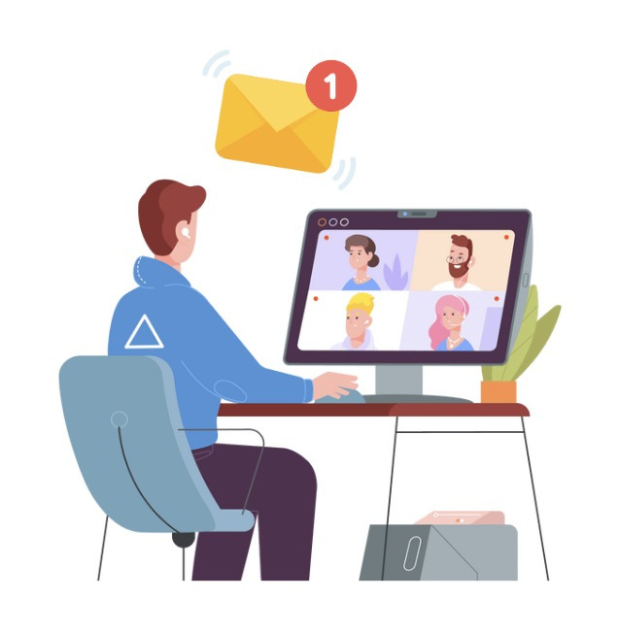
Example: sending reminder emails
Open-ended
Complex
Adaptive
→ IT solution
BUILDING SCALABLE AGENTIC SYSTEMS

Slide 31

Example: IT support agent
Open-ended
Complex
Adaptive
→ Investigate AI agent solution
BUILDING SCALABLE AGENTIC SYSTEMS

Slide 32
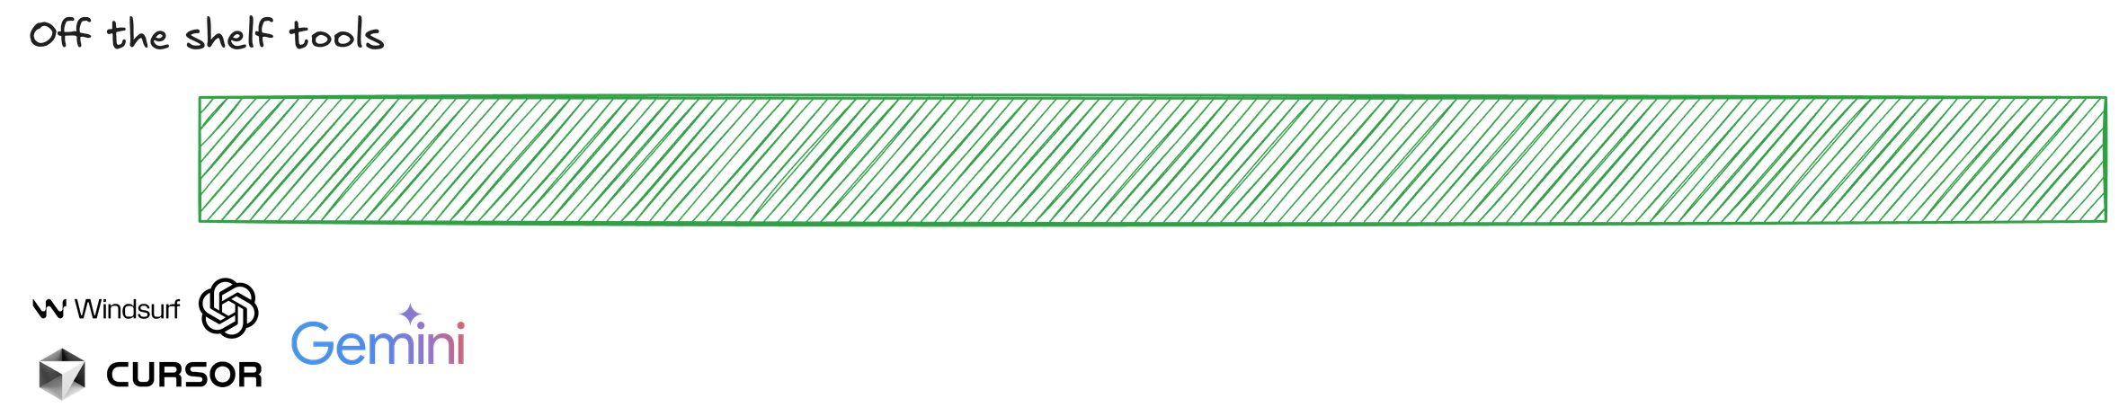
The AI Agents Tooling Ecosystem
INTRODUCTION TO AI AGENTS

Slide 33
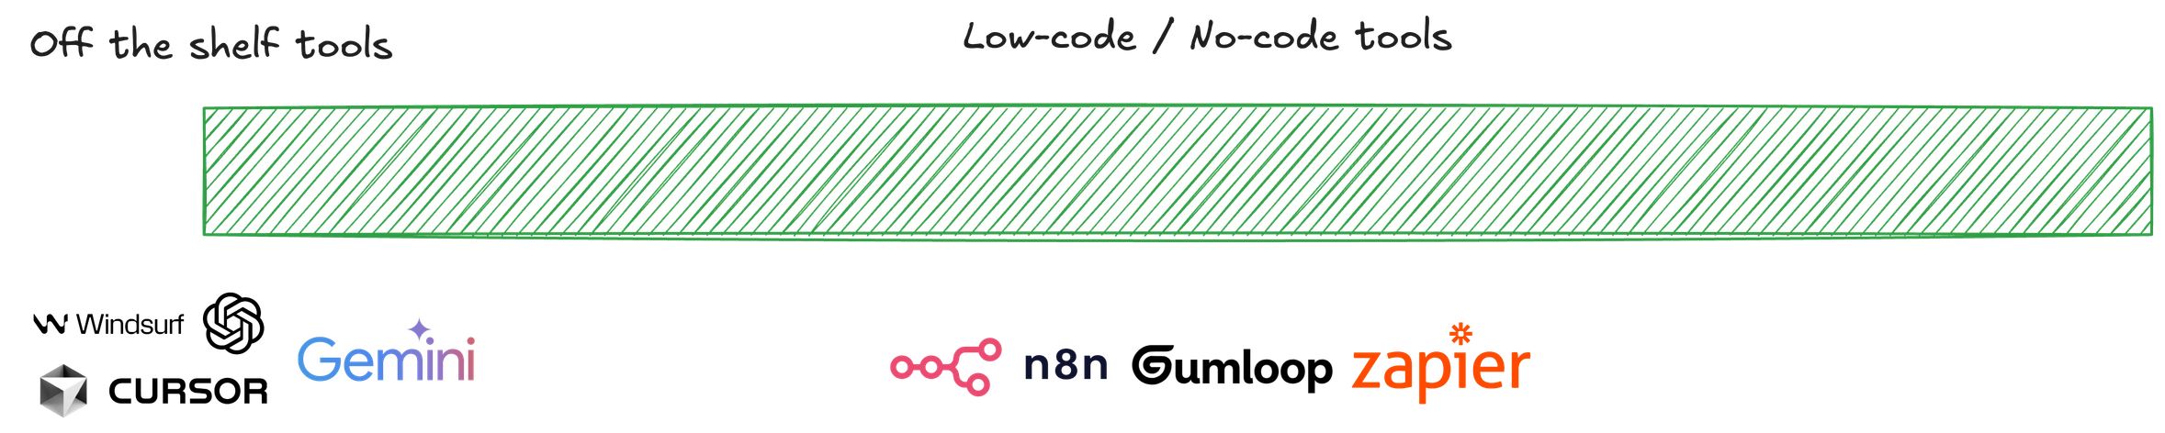
The AI Agents Tooling Ecosystem
INTRODUCTION TO AI AGENTS

Slide 34
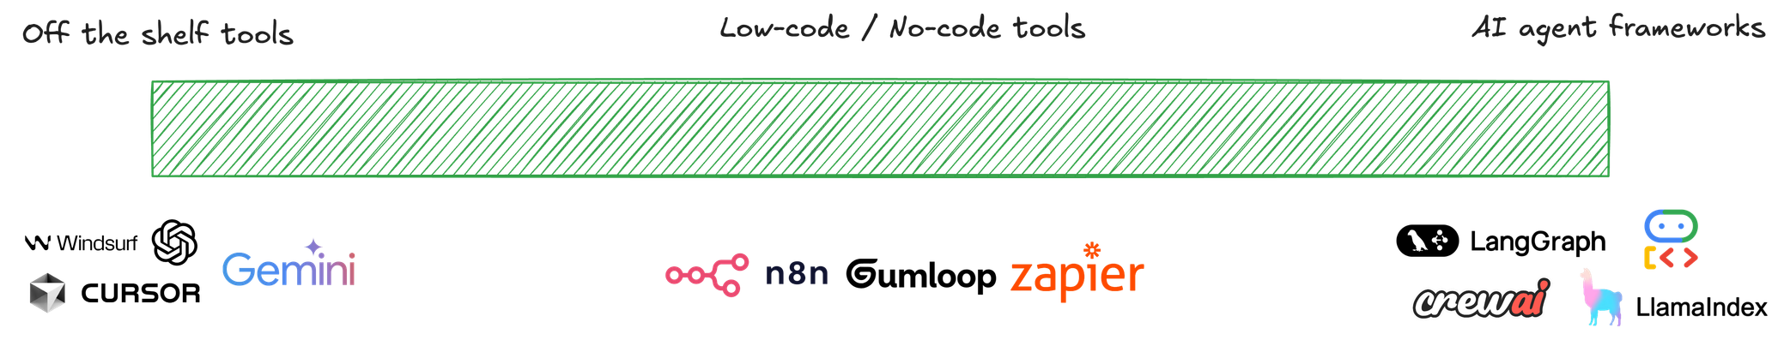
The AI Agents Tooling Ecosystem
INTRODUCTION TO AI AGENTS

Slide 35
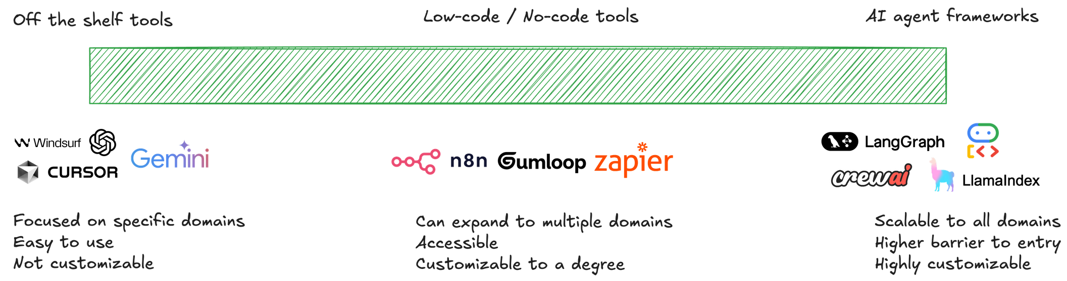
The AI Agents Tooling Ecosystem
INTRODUCTION TO AI AGENTS

Slide 36
Build vs Buy: A Framework
Off-the-Shelf Tools
Tackling a specific domain or use-case (e.g. AI-assisted coding) Mature, well-tested solution already exists in market
Want to minimize maintenance overhead
INTRODUCTION TO AI AGENTS

Slide 37
Build vs Buy: A Framework
Off-the-ShelfTools
Tackling a specific domain or use-case (e.g. AI-assisted coding)
Low-Code/No-Code Platforms
Need some customization but not complete control
Mature, well-tested solution already exists inWorkflows are moderately complex but follow
market
Want to minimize maintenance overhead
common patterns
Want business users to modify the agent without engineering help
Need to integrate with existing systems quickly
INTRODUCTION TO AI AGENTS

Slide 38
Build vs Buy: A Framework
Off-the-Shelf Tools
Tackling a specific domain or use-case (e.g. AI-assisted coding)
Mature, well-tested solution already exists in market
Low-Code/No-Code Platforms
Need some customization but not complete control
Workflows are moderately complex but follow common patterns
Want business users to modify the agent without engineering help
Need to integrate with existing systems quickly
Agent Frameworks (Build)
Use case involves proprietary systems
Handling sensitive data
Want to minimize maintenance overhead
Agent is core to
competitive advantage
No existing solution meets specialized requirements
Need complete control over agent's behavior and evolution
INTRODUCTION TO AI AGENTS

Slide 39
Working of Agent
Adel Nehme
VP of AI Curriculum, DataCamp

Slide 40
The Agentic Trinity: Model, Tools, and Orchestration
1
INTRODUCTION TO AI AGENTS

Slide 41
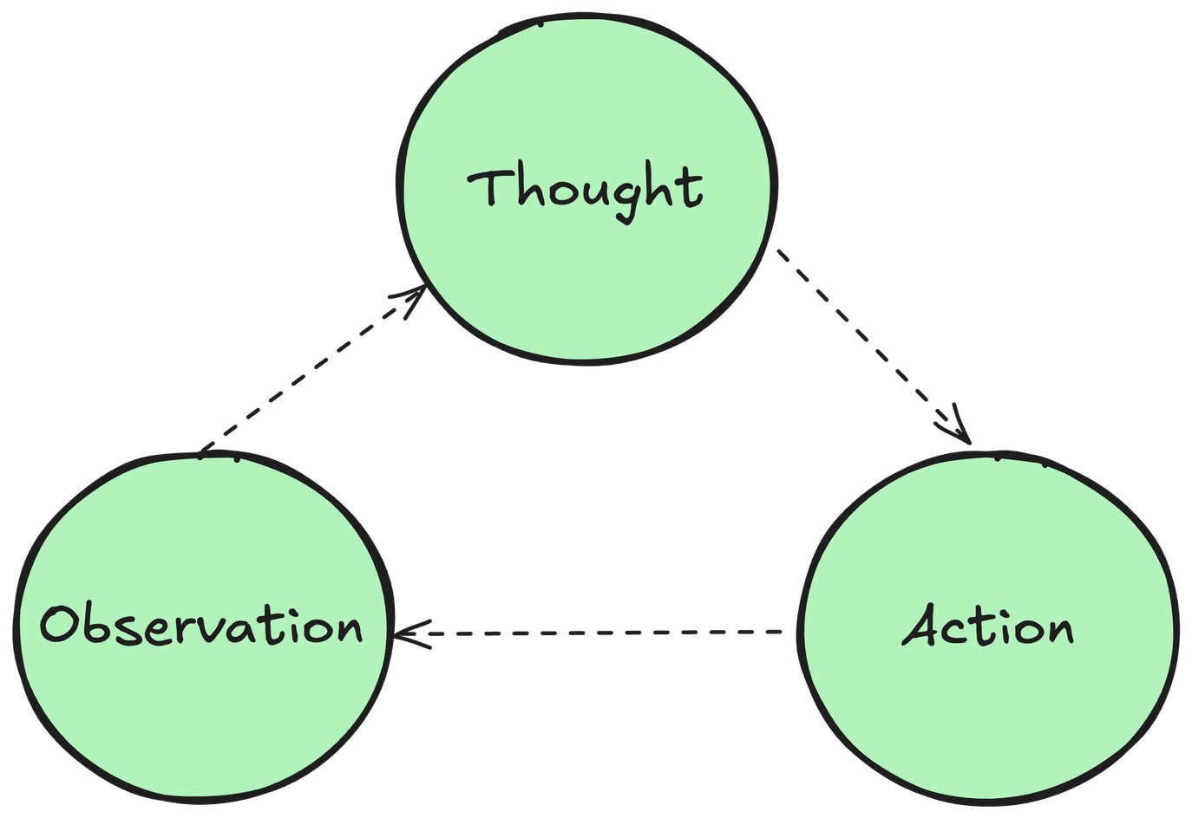
The Thought-Action-Observation Cycle
1
INTRODUCTION TO AI AGENTS

Slide 42
The Thought-Action-Observation Cycle
Thought: The model decides the next step based on the user prompt.
1
INTRODUCTION TO AI AGENTS

Slide 43
The Thought-Action-Observation Cycle
Action: The agent takes an action, by calling the tools at their disposal.
1
INTRODUCTION TO AI AGENTS

Slide 44
The Thought-Action-Observation Cycle
Observation: The model reflects on the response from the tool. Feeding into the next set of thoughts and actions.
1
INTRODUCTION TO AI AGENTS

Slide 45
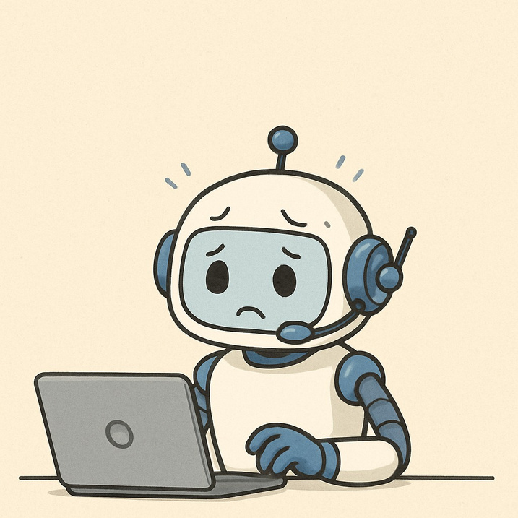
A Customer Support Agent Example
"I forgot to cancel my subscription and was accidentally billed. Help me get a refund."
1
Image generated with GPT-4o
INTRODUCTION TO AI AGENTS

Slide 46
The Thought-Action-Observation Cycle
Cycle Thought
Action
Access customer database and retrieve subscription history
Observation
Customer has premium plan, renewed 3 days ago for $99
"I need to understand this customer's situation. Let me check their account details."
1
INTRODUCTION TO AI AGENTS

Slide 47
The Thought-Action-Observation Cycle
Cycle Thought
Action
Access customer database and retrieve subscription history
Query company policy database for refund rules
Observation
Customer has premium plan, renewed 3 days ago for $99
Policy allows full refunds within 7 days for accidental renewals
"I need to understand this customer's situation. Let me check their account details."
"The renewal is recent. I should check our refund policy for accidental renewals."
1
2
INTRODUCTION TO AI AGENTS

Slide 48
The Thought-Action-Observation Cycle
Cycle Thought
Action
Access customer database and retrieve subscription history
Query company policy database for refund rules
Initiate refund transaction through payment system
Observation
Customer has premium plan, renewed 3 days ago for $99
Policy allows full refunds within 7 days for accidental renewals
Refund of $99 successfully processed
"I need to understand this customer's situation. Let me check their account details."
"The renewal is recent. I should check our refund policy for accidental renewals."
"Great, they qualify! Now I need to process the refund."
1
2
3
INTRODUCTION TO AI AGENTS

Slide 49
The Thought-Action-Observation Cycle
Cycle Thought
Action
Access customer database and retrieve subscription history
Observation
Customer has premium plan, renewed 3 days ago for $99
Policy allows full refunds within 7 days for accidental renewals
Refund of $99 successfully processed
Email sent, subscription cancelled, ticket can be closed
"I need to understand this customer's situation. Let me check their account details."
1
"The renewal is recent. I should check our refund policy for accidental renewals."
Query company policy database for refund rules
Initiate refund transaction through payment system
Send confirmation email and update subscription status to 'cancelled'
2
3
"Great, they qualify! Now I need to process the refund."
"Refund complete. I should update the customer and cancel their subscription to prevent future charges."
4
INTRODUCTION TO AI AGENTS

Slide 50
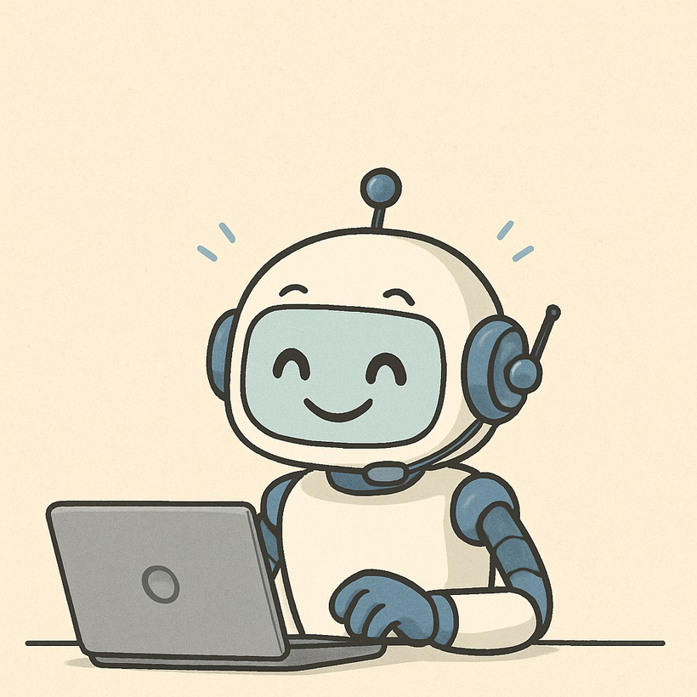
The Thought-Action-Observation Cycle
Final action: Ticket now can be closed
1
Image generated with GPT-4o
INTRODUCTION TO AI AGENTS

Slide 51
Lifecycle of AI Agent

Slide 52
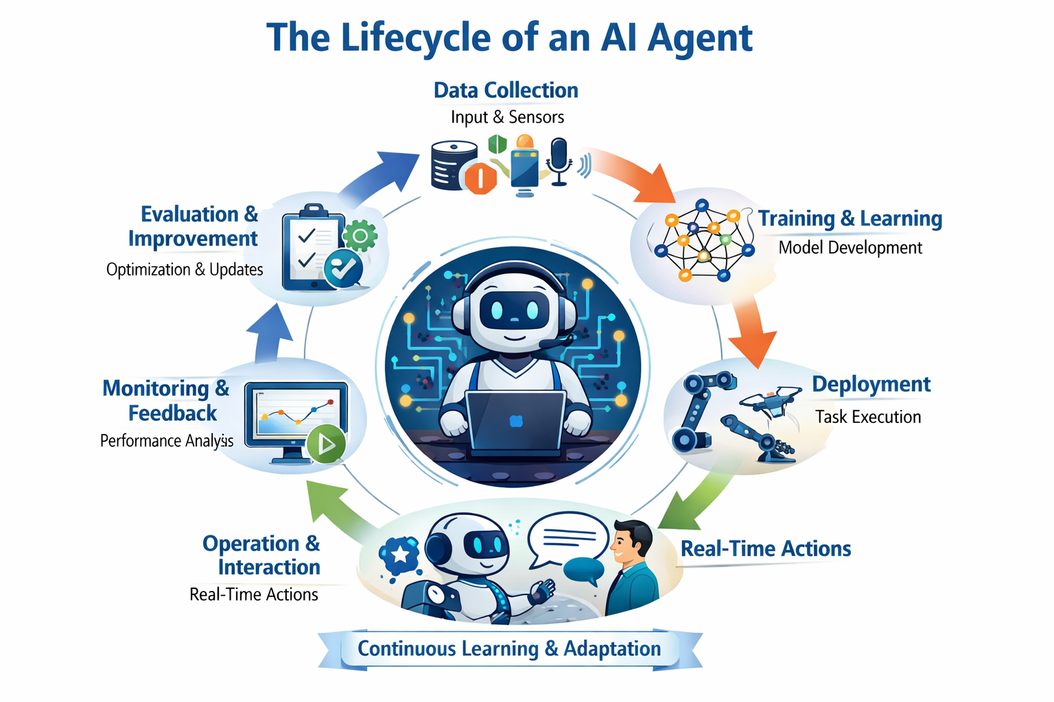

Slide 53
Lifecycle of AI Agent
Data Collection
The agent gathers raw information from various sources such as sensors, databases, or user interactions.
This data forms the foundation for learning and decision-making.
Training & Learning
The collected data is processed to train machine learning models.
Algorithms learn patterns, relationships, and behaviors to perform specific tasks effectively.
Deployment
The trained model is integrated into real-world systems or applications.
It starts executing tasks—like predictions, automation, or interactions—based on learned knowledge.

Slide 54
Lifecycle of AI Agent
4.Operation & Interaction
The AI agent operates in its environment, interacting with users or other systems.
It applies its learned intelligence to make decisions and respond dynamically.
5.Monitoring & Feedback
Performance is tracked continuously to detect errors, inefficiencies, or drift.
Feedback from users or system logs helps identify areas for improvement.
6Evaluation & Improvement
The agent’s outcomes are analyzed to refine algorithms and retrain models.
Updates and optimizations ensure the agent adapts to new data and evolving conditions.
🔁 Continuous Learning & Adaptation
The cycle repeats, allowing the AI agent to evolve, improve accuracy, and remain relevant over time.

Slide 55
Thank You !!

